Slide 1
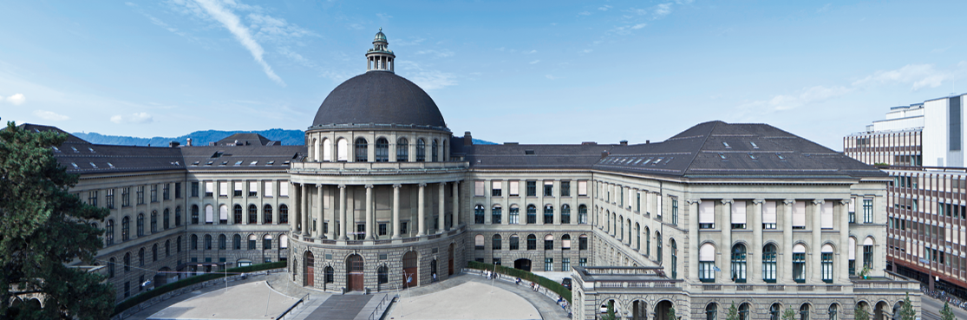
Joint 3D Scene Reconstruction and Class Segmentation
3D Vision – CVG – ETH Zurich
Instructors: Prof. Marc Pollefeys, Dr. Torsten Sattler
Teaching Assistant: Yagiz Aksoy, Johnasses Schönberger, Thomas Schöps, Peidung Liu
Supervisors: Martin Oswald, Pablo Speciale
Students: Adrian Schneuwly, Johannes Oswald, Tobias Grundmann

Slide 2
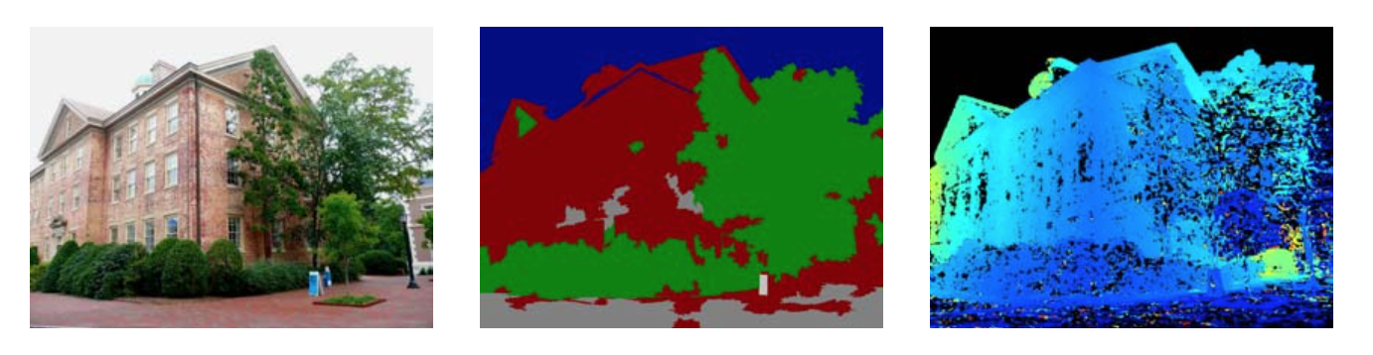
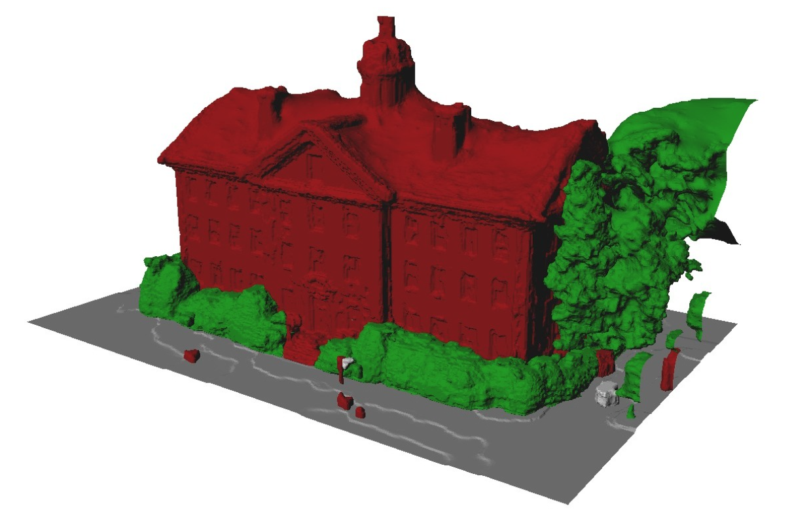
Problem & Motivation
Both ill-posed problems:
  Image segmentation
  Dense 3D modeling
Solution: Regularizers, but it often fails
Papers approach:
  Joint segmentation and dense reconstruction
Why does this makes sense?
Image segmentations
-> clues about surface orientation
Dense 3D reconstruction
-> yields a suitable regularization for segmentation
Input Image
Classification
Depthmap
Result: Accurately labeled 3D reconstruction
Source: Hane_Joint_3D_Scene_2013_CVPR_paper

Slide 3
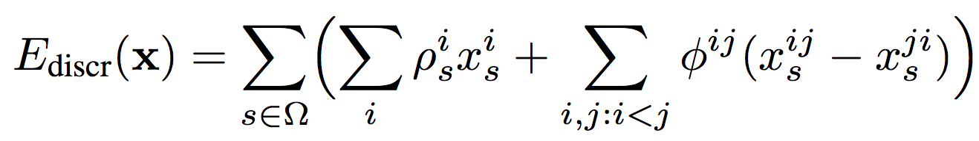
Problem Formulation
sdfdsf

Slide 4
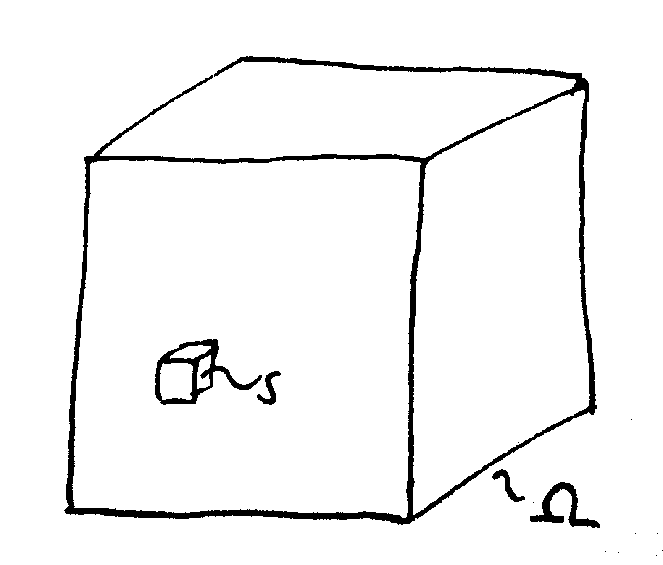
Problem Formulation
Minimize convex energy function
always has a solution

Slide 5
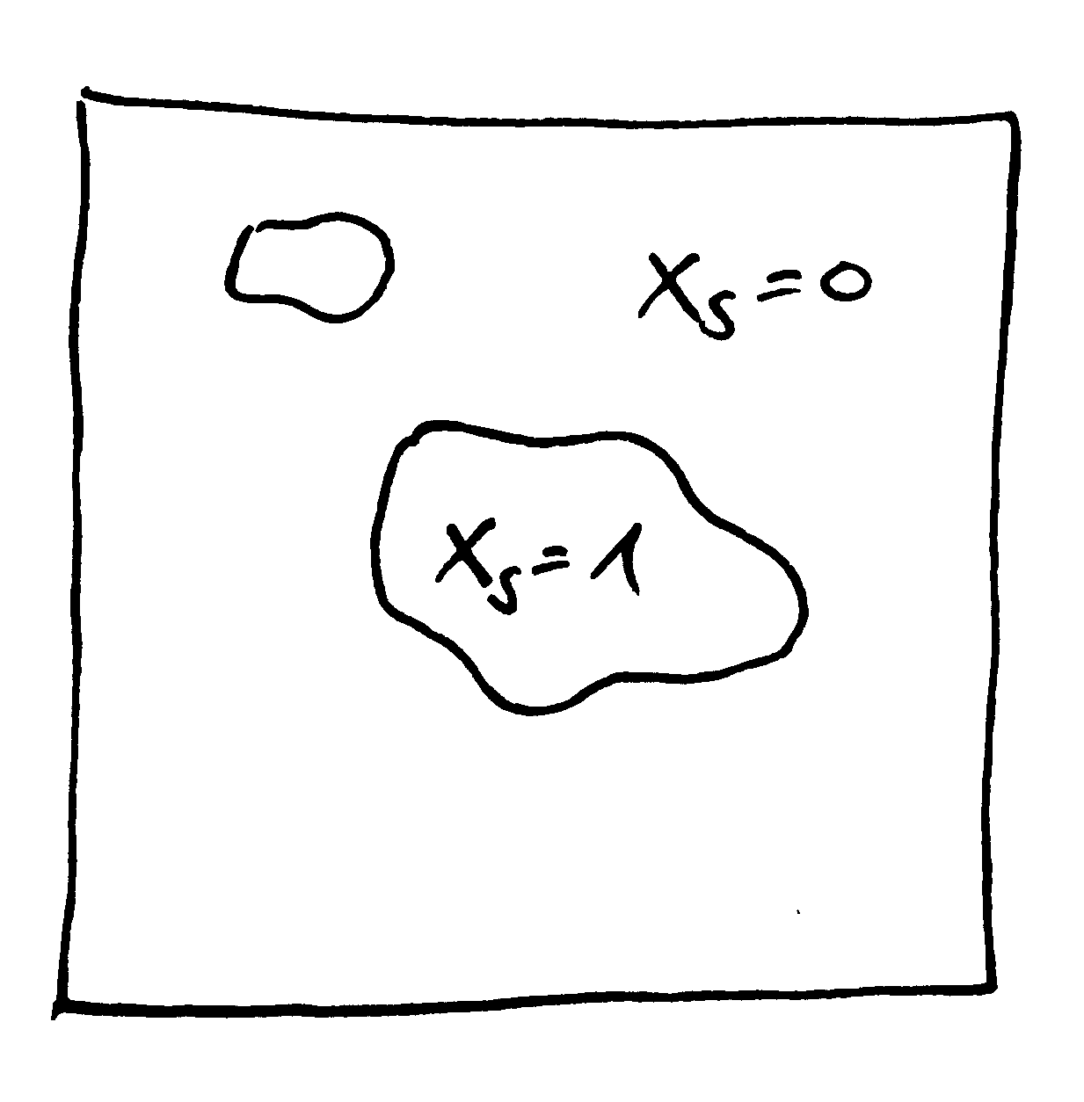
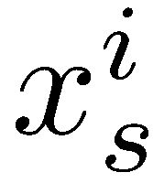


Data Term
TODO explain x
Preference of voxel s for a particular label i

Slide 6
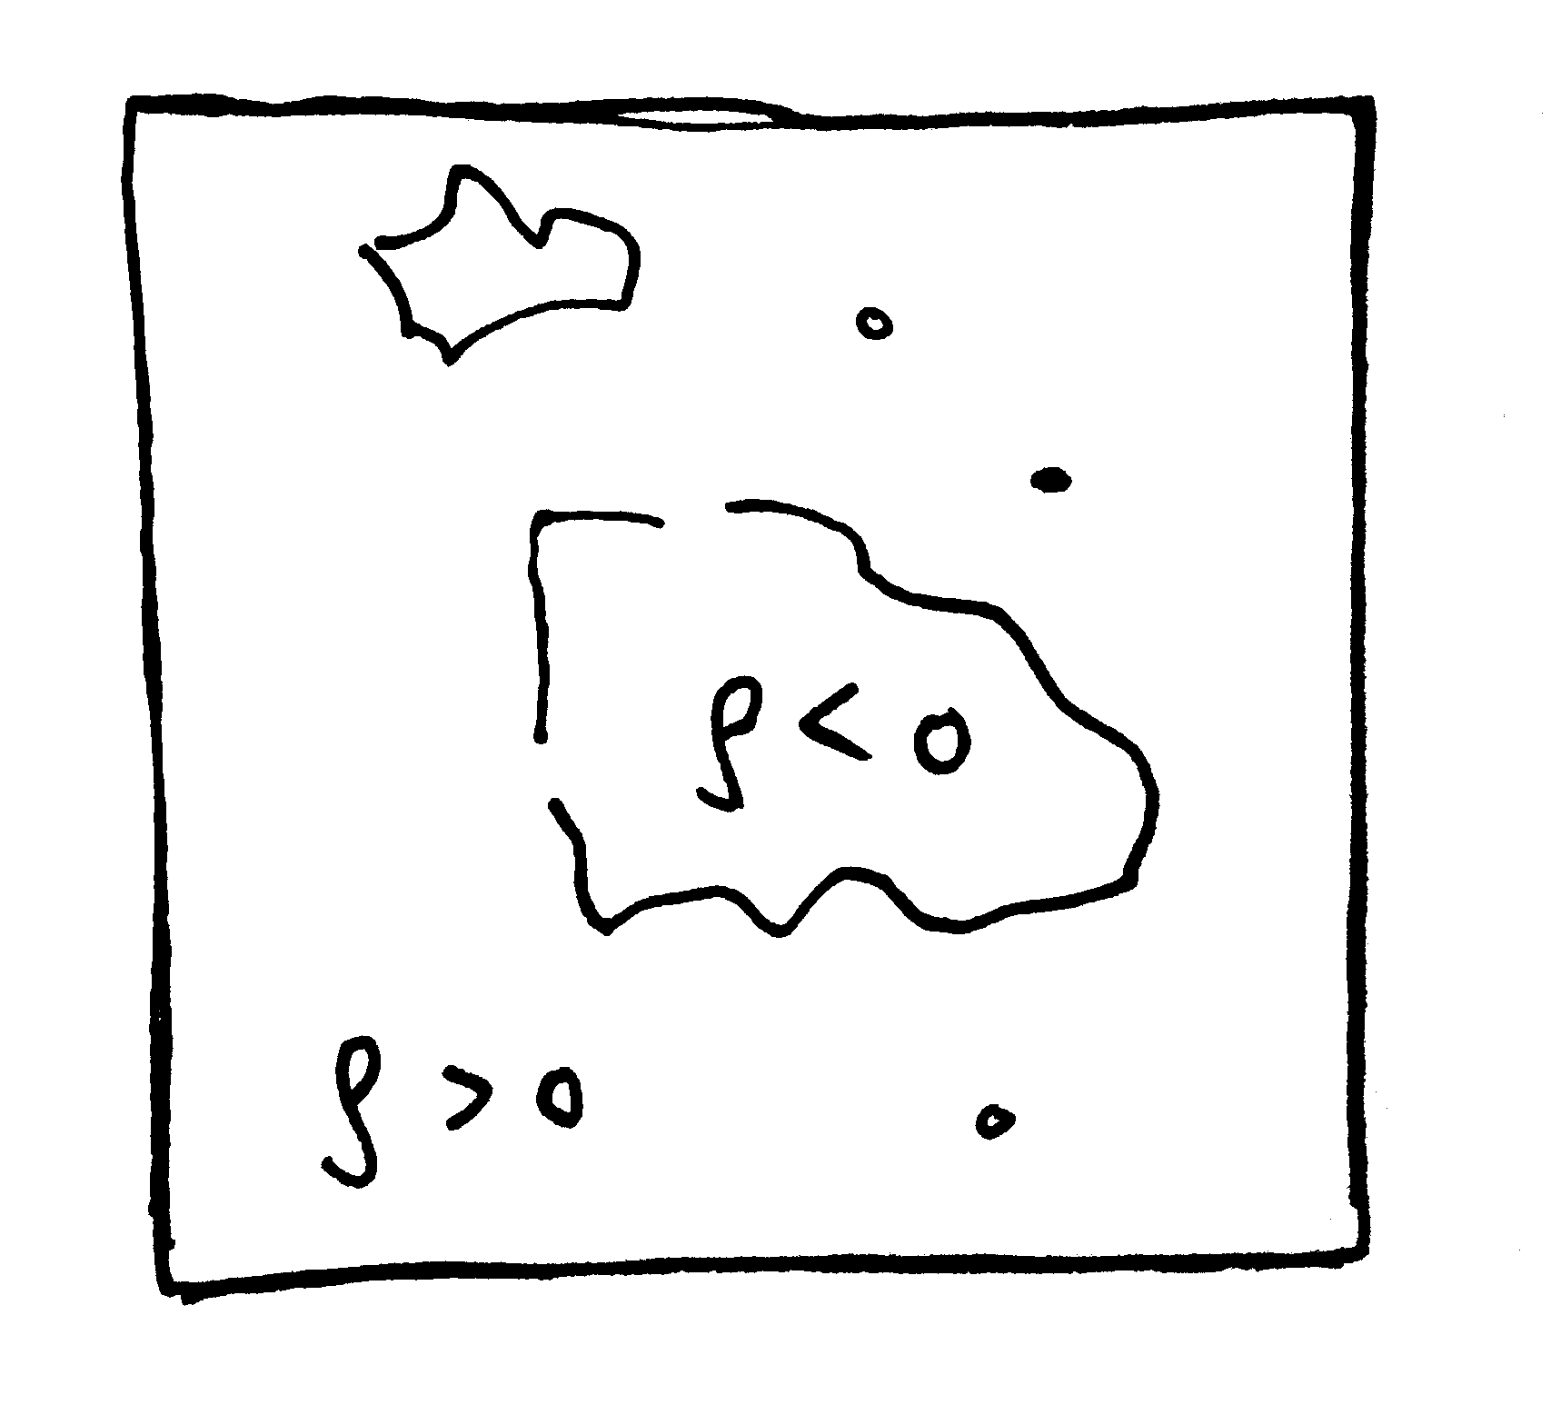
Data Term
missing parts
TODO explain x
Preference of voxel s for a particular label i

Slide 7
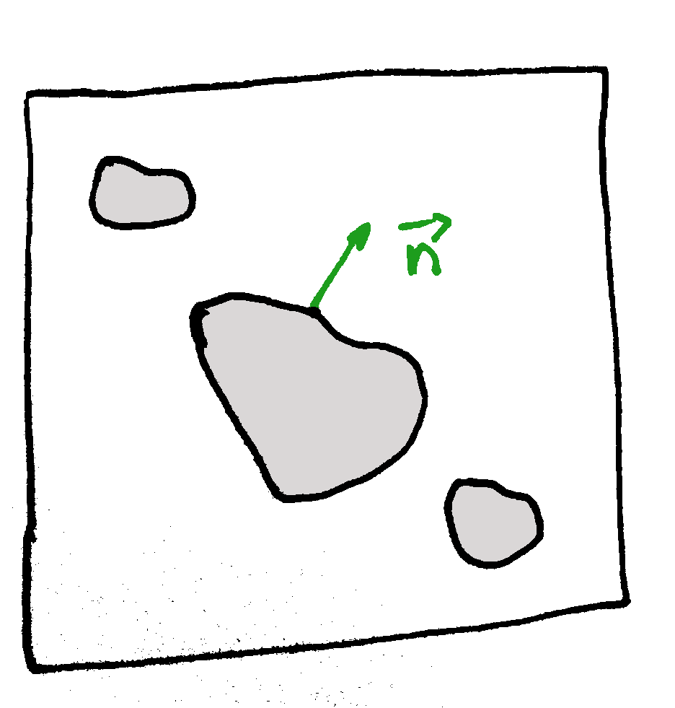
Regularization Term
weight
local surface orientation
think of it as a gradient
Minimize surface (boundary)
Increase in surface smoothness
contributes
no change → zero

Slide 8
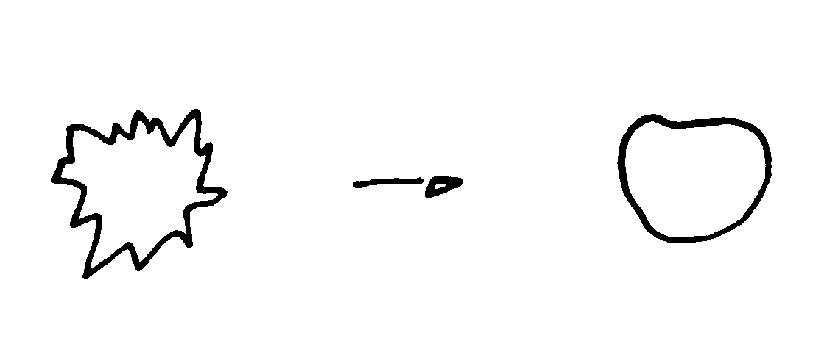
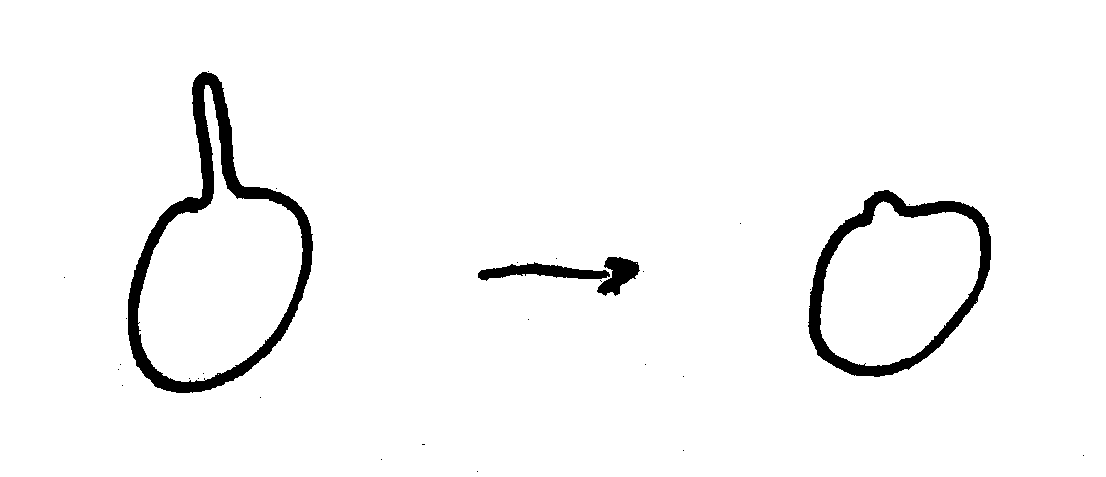
Regularization Term (2)
weight
local surface orientation
Examples:
Weight
  Make certain directions of surface mor/less costly

Slide 9
Labels
Examples:

